Slide 1
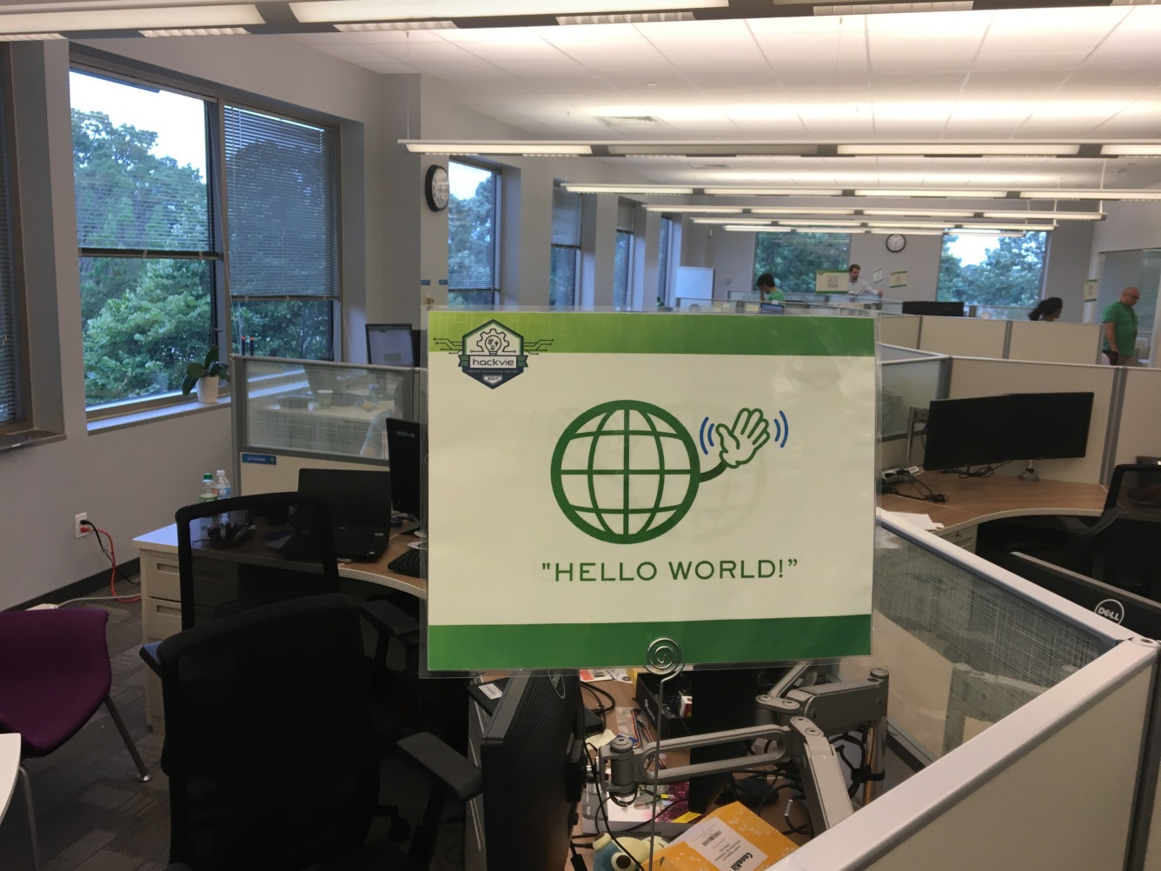
ReTA
(Real Time Alerts)
Notes:
Key Points for Meetings:
What do the Innovation Pillars mean for our organization (AbbVie and function)?
What are your questions/observations?
What do you need from R&D?
What can help us in gaining buy-in/adoption of these in your organization?

Slide 2





ReTA
Sensor
Participant in Clinical Trials
2

Slide 3
ReTA
A system to send text messages to Doctors, AbbVie employees and other participants during clinical trials
Can be used to alert in real time and can prevent or mitigate adverse events
Concept can be extended in future

Slide 4
Demo | Future
Shown with Temperature Sensors Light(RGB Sensors) Button sensors | Can be extended by AbbVie with Wearables Apple Watch Fitbit Biometric Implants

Slide 5
DEMO

Slide 6
Tools
RaspBerry Pi
Button sensor
Light sensor
RGB sensor
Python
Twilio library(for sending messages)

Slide 7
Other ideas considered
Experimented with Fitbit data to trigger text alerts to Doctors, Medical providers
Mining data from patients network such as patientslikeme.com
Matching symptoms with drugs/diseases

Slide 8

Questions

